Slide 1

Project Title – Design and develop your own Portfolio single page application
Gandhar Khare
PES Modern COE

Slide 2

PROBLEM STATEMENT
This portfolio website helps the recruiter to understand my details

Slide 3
Project Description This site contains information about me, my work experience and educational details

Slide 4

WHO ARE THE END USERS?
Recruiter
Student

Slide 5

Technology Used
HTML
CSS
JAVA

Slide 6
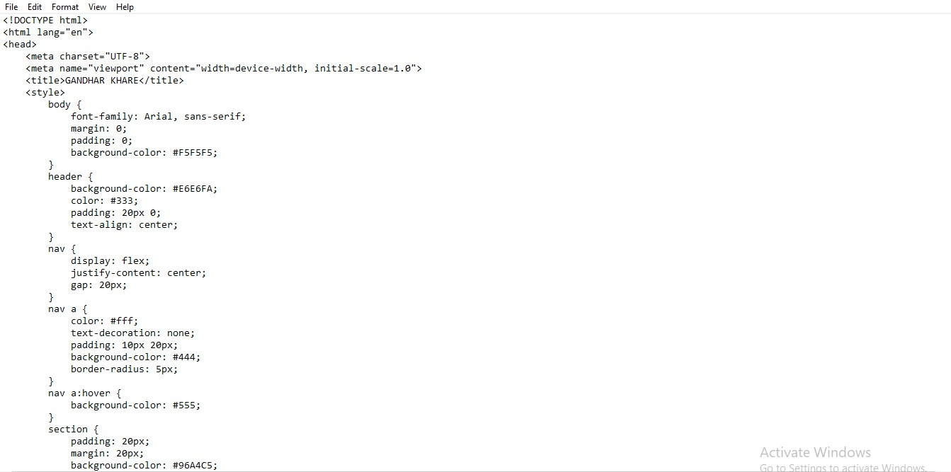
RESULTS
Demo Link

Slide 7
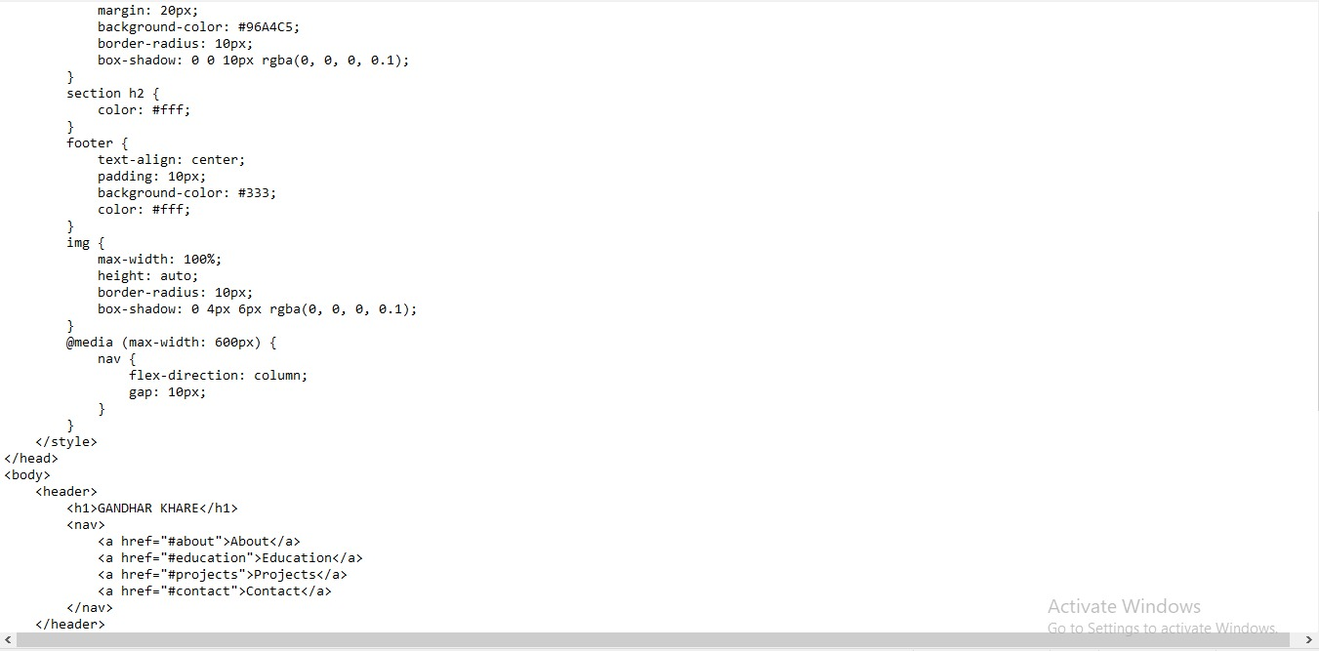

Slide 8
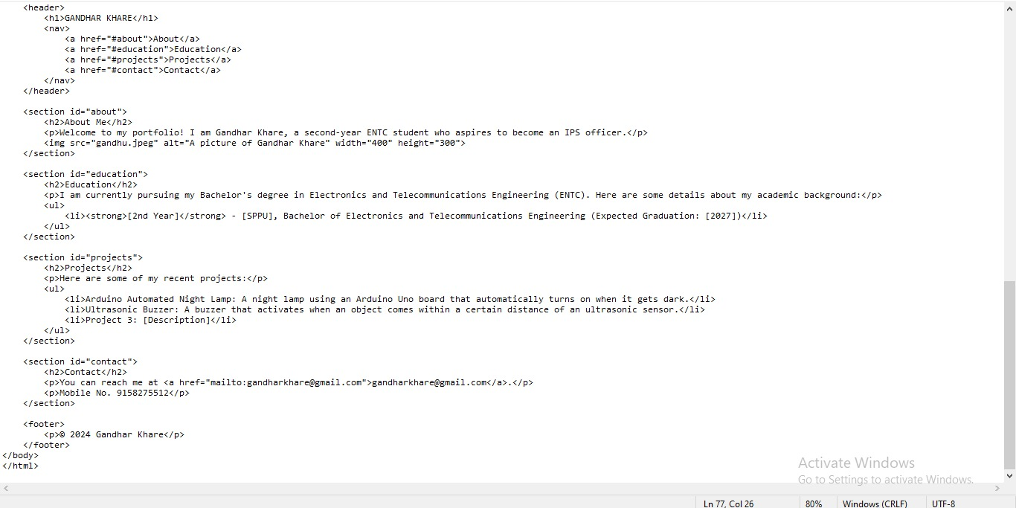

Slide 9
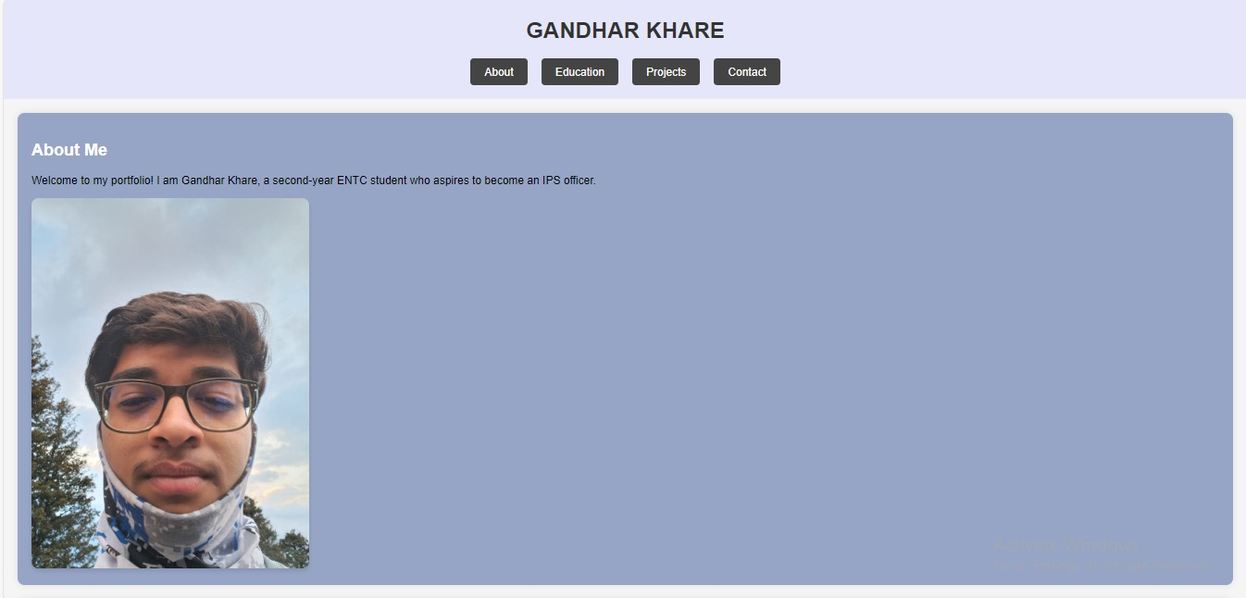

Slide 10
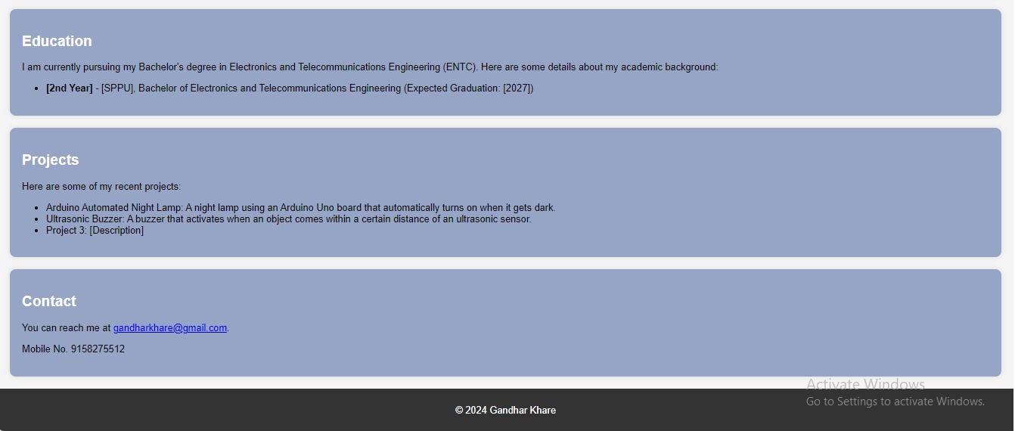

Slide 11
Thank you
.
.

